Slide 1
Information Retrieval
Data Science for Biomedical Informatics (BMIN503/EPID600)
Blanca E. Himes, Ph.D.
9/11/18

Slide 2
Getting and Cleaning Data
Can be most frustrating and time consuming step in data analysis
Some data scientists demand “clean” data prior to analysis
Can be a mistake
Good science depends on clean data, clean data depends on:
Good scientific judgment
A lot of tedious and careful work

Slide 3
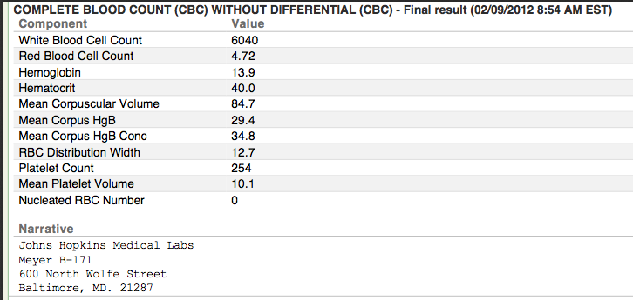
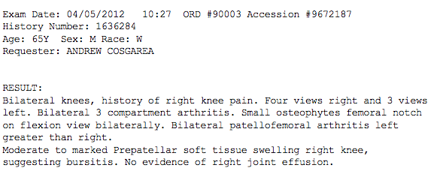
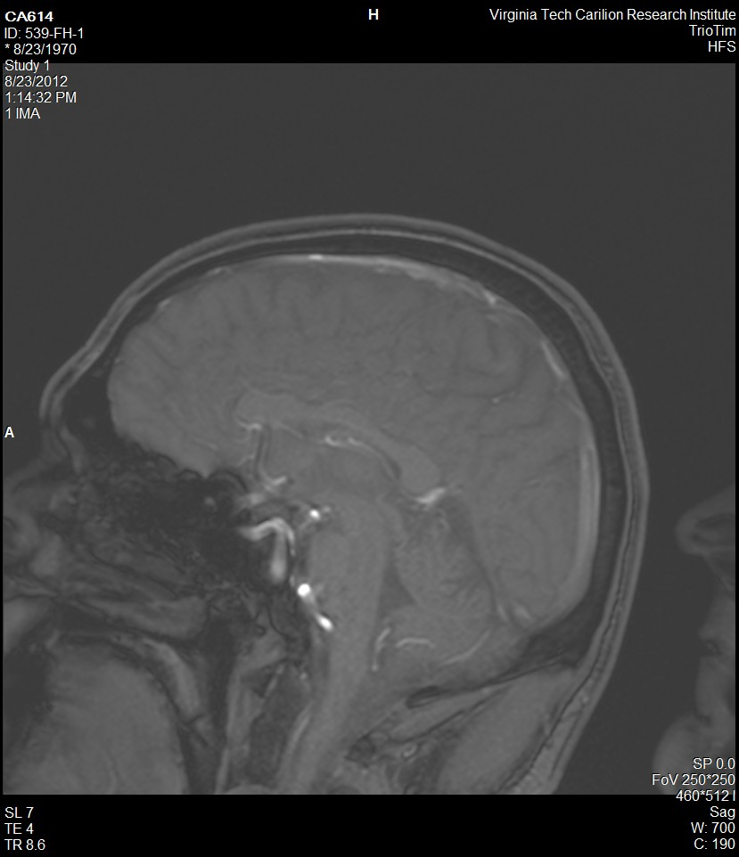
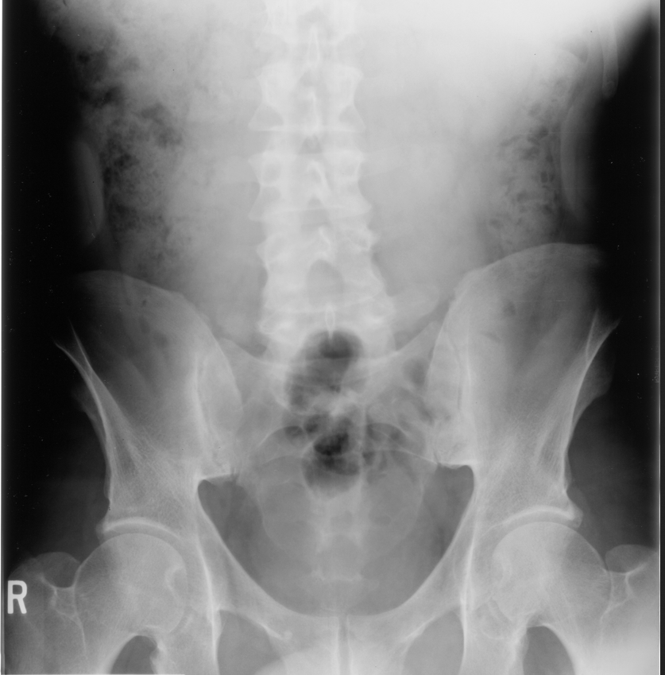
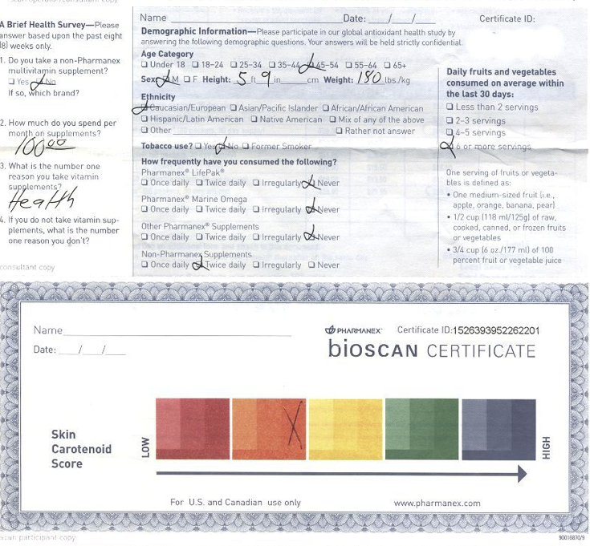
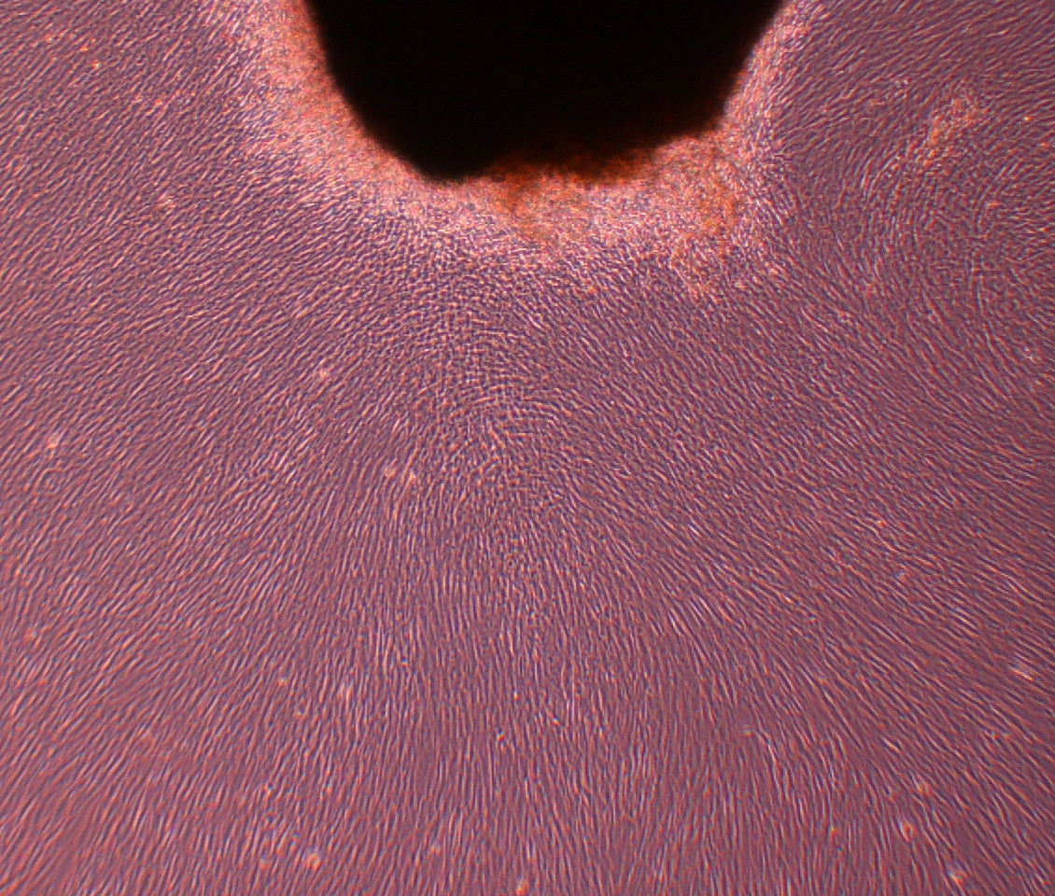
Raw Data

Slide 4
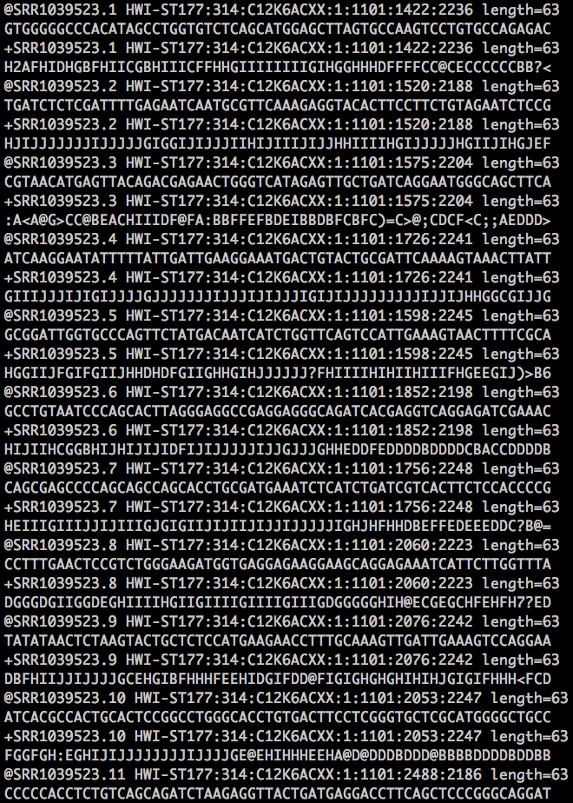
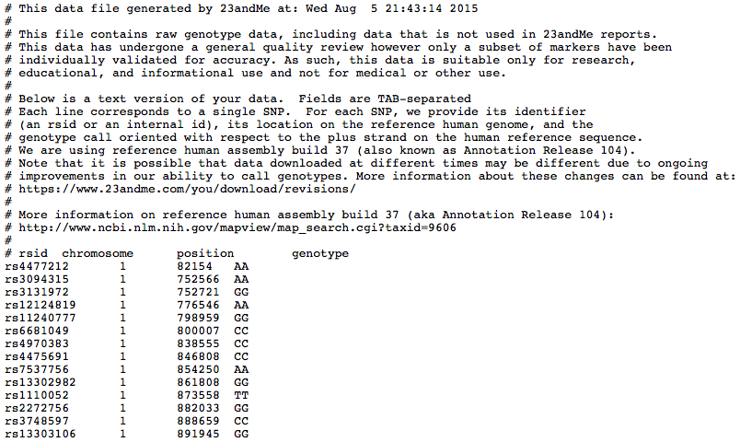
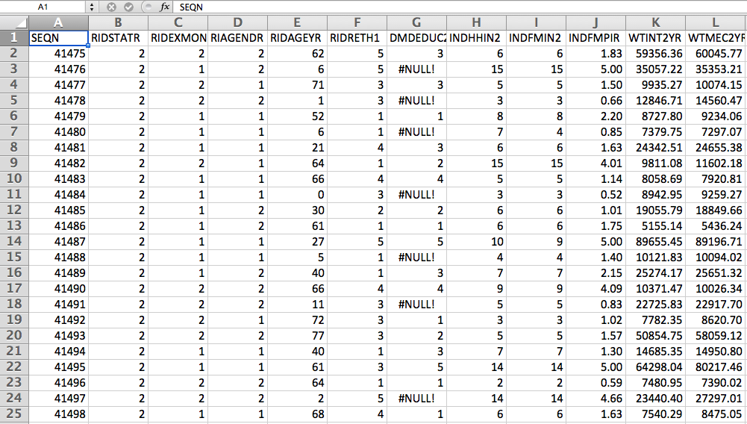
Clean Data

Slide 5
Clean Data
Table of
Rows: individual observations
Columns: individual variables
May have multiple such tables, linked by identifiers
Code book with metadata may be necessary/helpful:
Data dictionary
Origin of data
Experimental design
Start with clean but UNPROCESSED data, or know how it has been pre-processed

Slide 6
Use Code to Clean Data
Helps simplify and quicken preparation of data
Increases reproducibility of results
Write into a script (.R or .Rmd)
Add comments to describe all steps and rationale for choices
Include download process of external data in scripts to maximize reproducibility

Slide 7
Standards and Analysis Pipelines
Several biomedical informatics data types are common so there are standards for
Data file formats
Data pre-processing
Analysis
Not always the case!
Either way, become as familiar as possible with all steps involved in generating data you use
Errors in pre-processing can greatly impact downstream results

Slide 8
Basic Data Characteristics
Qualitative
Country of origin, gender, medications
Quantitative
Height, blood pressure, expression levels for a gene

Slide 9
Basic Data Characteristics
Binary
Two non-overlapping outcomes
Categorical
Distinct categories can be represented as integers
Continuous
Can have any value within a range of numbers

Slide 10

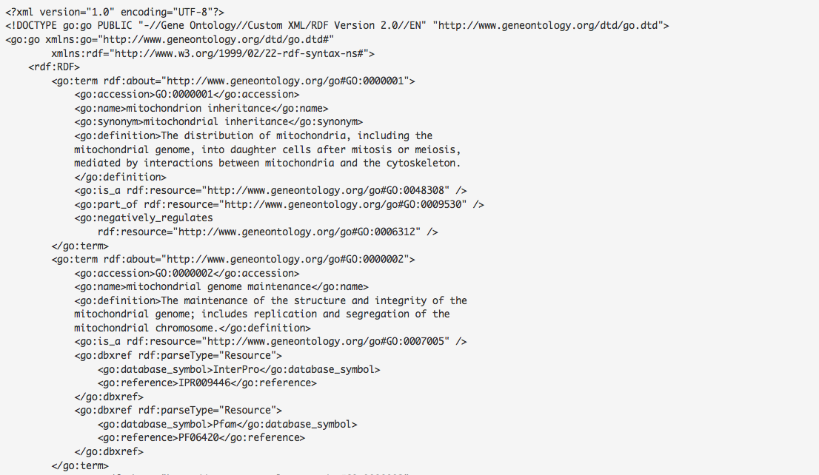
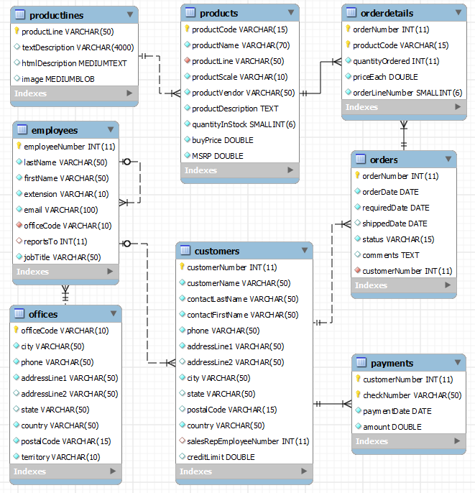
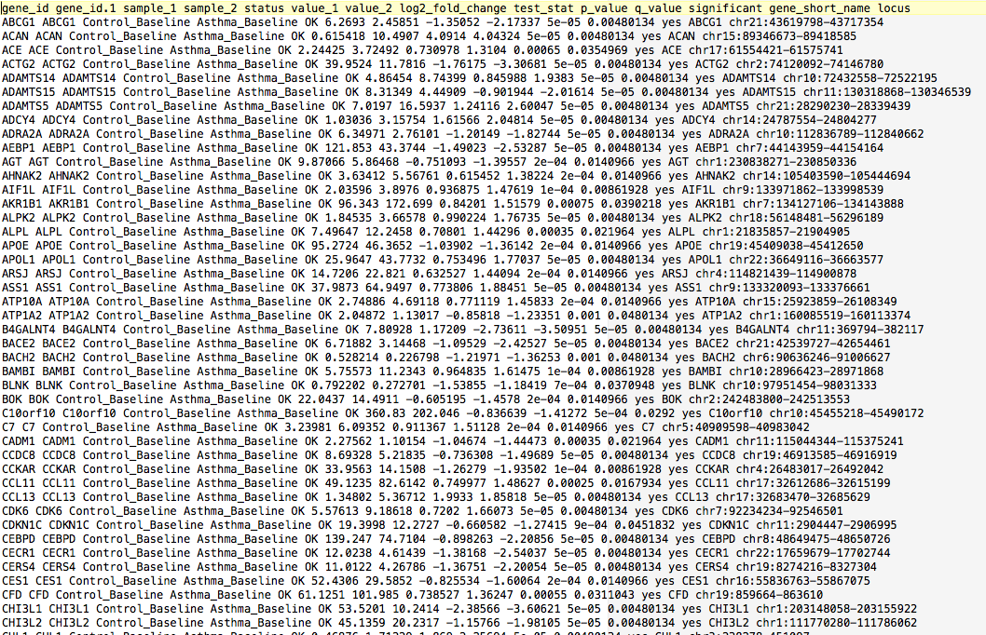
Sources of Data
Text files
Databases
Websites
Social media platforms

Slide 11
Tabular Text Files
The most common format used
Tab-delimited: “\t” .txt
Space-delimited: “ “ .txt
Comma-delimited: “, “ .csv
Encoding can affect portability
Be aware of origin of file if you have trouble opening one

Slide 12
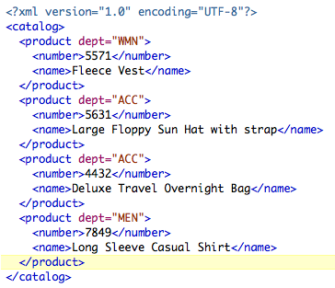
Other Common Formats: XML
Extensible Markup Language
Data format common in web apps
Consists of “markup” labels that begin and end with tags
Within tags are content of specific instances
Attributes can be assigned to tags
https://blogs.datadirect.com/2010/11/dude-you-got-soap-in-my-filesystem.html

Slide 13
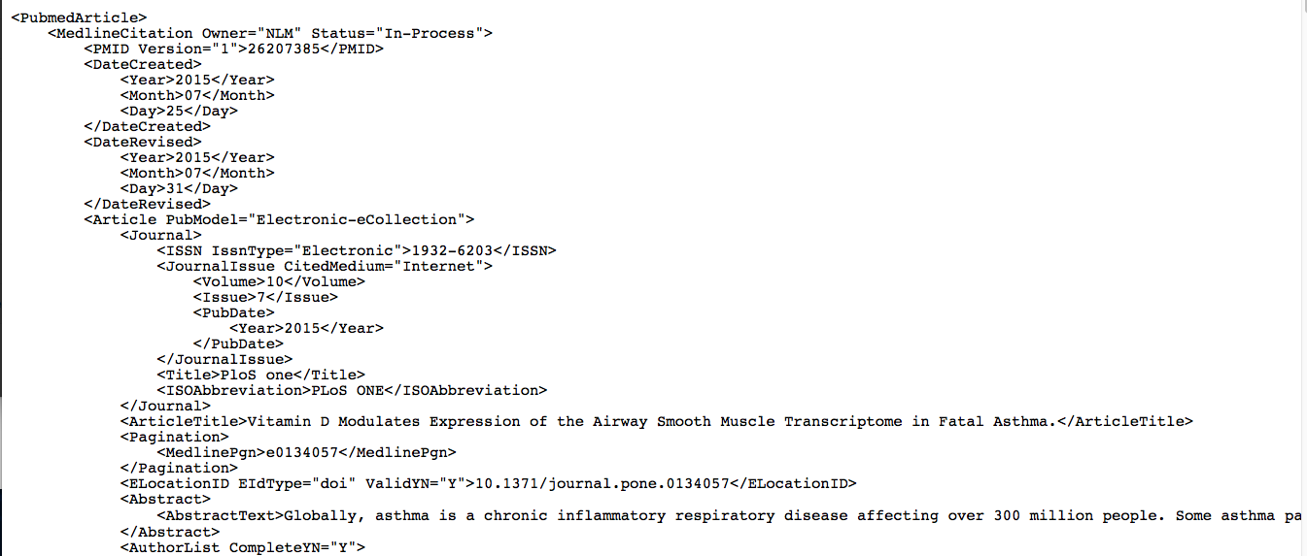
XML Format in Biomedicine
Pubmed
Ontologies
Notes:
older

Slide 14
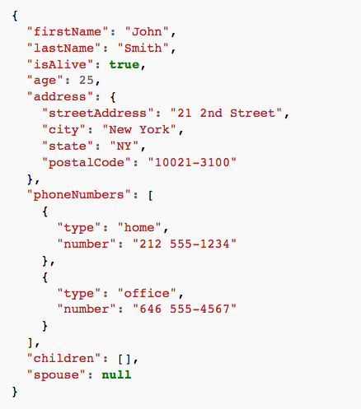
Other Common Formats: JSON
Javascript Object Notation
Data format common for application programming interfaces (APIs)
Effective for quick server-to-browser communication
Consists of attribute:value pairs
https://en.wikipedia.org/wiki/JSON
Notes:
Newer
APIs use it

Slide 15
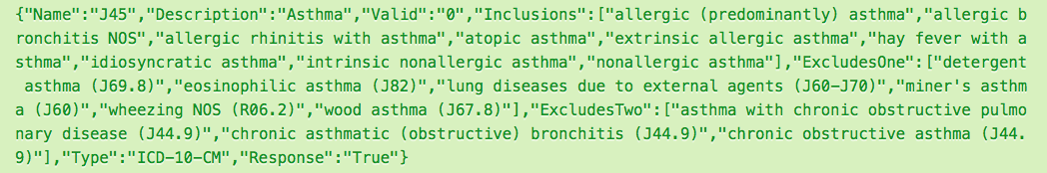
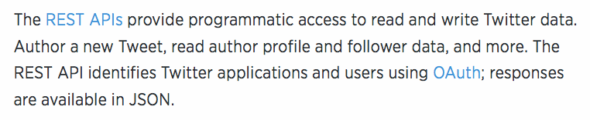
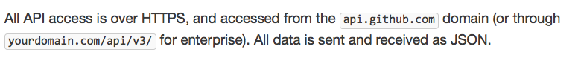
JSON Format in Biomedicine
Ontologies
APIs for major websites
ICD-10-CM Code for Asthma:
Twitter API:
GitHub API:
https://dev.twitter.com/rest/public
http://www.icd10api.com/
https://developer.github.com/v3/

Slide 16
Other Common Formats: HDF5
Hierarchical Data Format
Unique technology suite that makes possible the management of extremely large and complex data collections
Versatile data model to represent complex data objects and metadata
No limit on number/size of data objects
Consists of:
groups: contain datasets/metadata
datasets: multidimensional arrays of data/metadata
https://portal.hdfgroup.org/display/HDF5/HDF5
Notes:
Best Big Data format

Slide 17
HDF5 Format in Biomedicine
Output of next-generation sequencing analysis programs (e.g. Kallisto)
NeuroHDF: software to manage neuroscience data
ITK: toolkit for performing registration and segmentation of medical images
https://www.hdfgroup.org/products/hdf5_tools/SWSummarybyType.htm

Slide 18
Websites
Webscraping: going through HTML code of websites and extracting data directly from them
Can be illegal, there may be a statement in Terms of Use prohibiting it, can get your IP address blocked
Direct connections to websites can be opened in R with url or other commands in the httr or RCurl packages

Slide 19
Application Programming Interfaces (APIs)
Major websites often have specific applications dedicated to developers being able to access/use their data
The httr R package can be used to access most APIs (e.g. Google, Twitter, Github)

Slide 20
Databases
We will not cover in great depth
MySQL
Open source, widely used database software
https://www.mysql.com
Notes:
Consider Database class with John Holmes

Slide 21
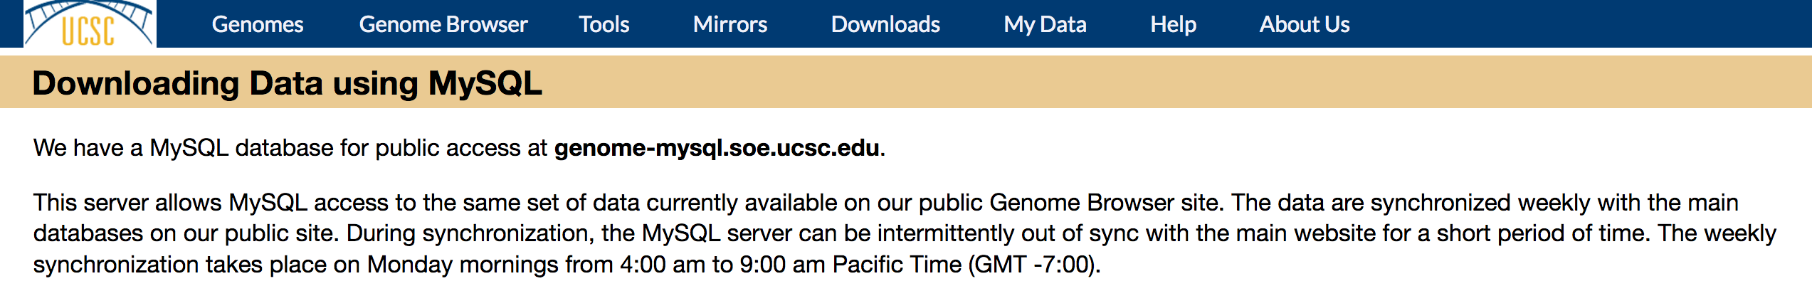
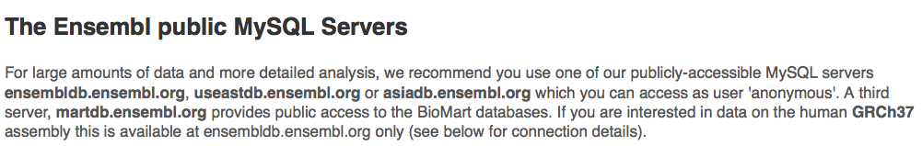
Databases
We will not cover in great depth
MySQL
Open source, widely used database software
If MySQL is installed on your computer, you can interface with R using RMySQL / RMariaDB package
https://www.mysql.com

Slide 22
Practicum 5
Go to course CANVAS page (https://canvas.upenn.edu)
Under “Files” download “5_information_retrieval.html” AND “5_information_retrieval.Rmd”

